Slide 1
Semantic HTML and Introduction to CSS
Front-End Web Development

Slide 2

Today’s Learning Objectives
In this lesson, you will:
Choose semantic HTML tags to define and organize content.
Use CSS to apply style to webpages.
Learn the basics of CSS syntax, including selectors and style rules.
‹#› | © 2020 General Assembly

Slide 3
Images
Front-End Web Development

Slide 4
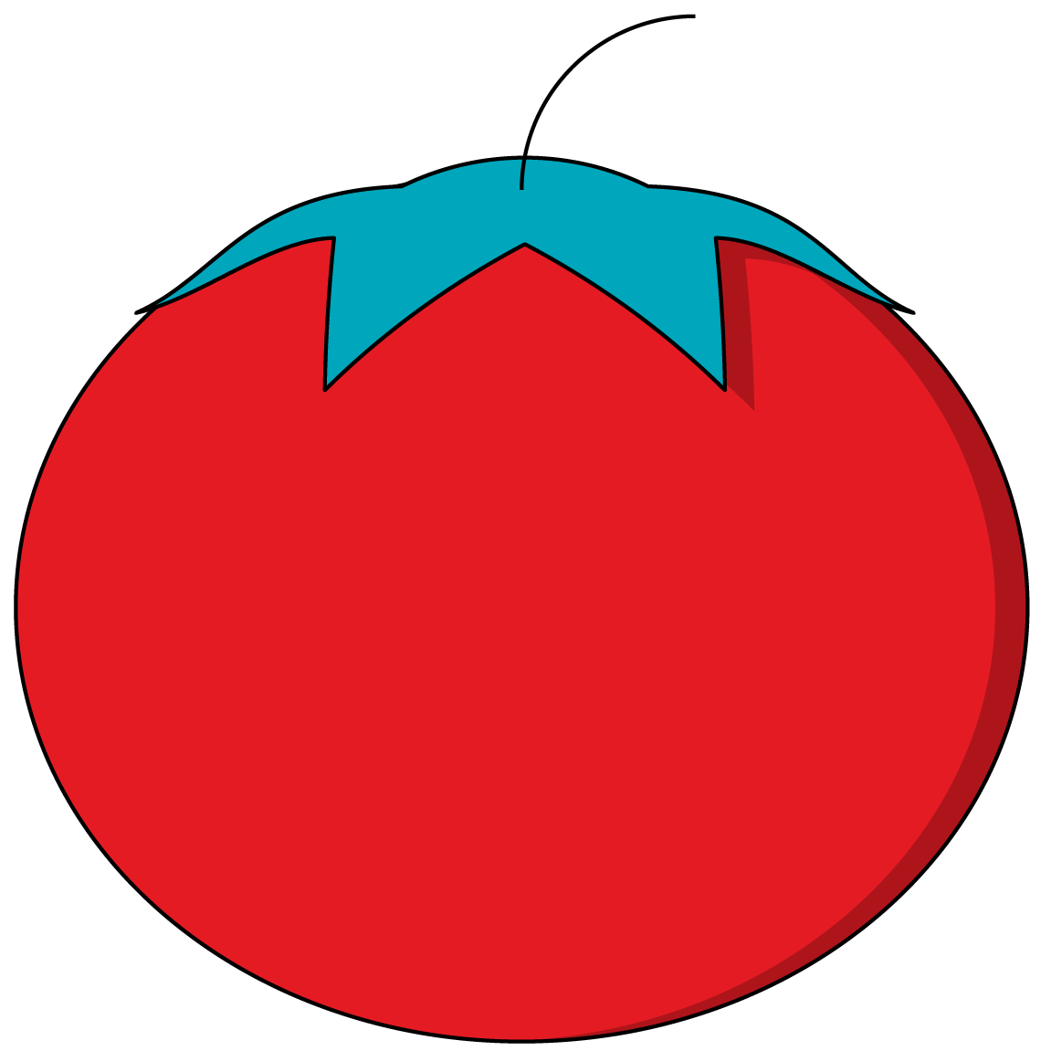
Images
The img tag requires a src attribute, which tells the browser where to find the image.

Slide 5
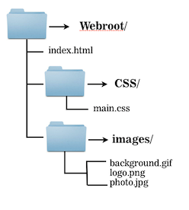
Images
How would you write the src?
There are different approaches to specifying an image location

Slide 6
Images
Relative Path
Absolute Path
<img src="images/logo.png">
<img src="/images/logo.png">
Full URL
<img src="https://ga-core.s3.amazonaws.com/production/uploads/ program/default_image/397/thumb_User-Experience-Sketching.jpg">

Slide 7
Image File Formats
There are 4 file formats:
JPG / JPEG
PNG
GIF
SVG

Slide 8
Semantic HTML
Front-End Web Development

Slide 9
HTML Review
10 minutes
Let’s review tagging content with a quick walk-through. The example solution contains plenty of tags you haven’t seen yet — don’t worry, they’ll come later! In the meantime, it’s good to challenge yourself by analyzing unfamiliar content.
Starter code:
https://codepen.io/GAmarketing/pen/JjjBWYd
Solution code:
https://codepen.io/GAmarketing/pen/XWWBMmL

Slide 10
Semantic Elements
Element | Description
main | Indicates the main content of a page.
header | Content placed above and contextualizing the main content.
nav | A navigation section, typically containing links or tabs.
section | Typically indicates one of several, equally placed segments of content.
aside | A sidebar of content placed next to and supplementing an element.
div | A “division” of the page; a very generic, non-semantic element.
‹#› | © 2020 General Assembly

Slide 11
Semantic HTML
10 minutes
How are the elements in the following HTML nested, and why would a developer write HTML this way?
<nav>
List of Links
</nav>
<main>
<section>
<div>
Content A
</div>
<div>
Content B
</div>
</section>
</main>
‹#› | © 2020 General Assembly

Slide 12

Cheat Sheet: Semantic Elements
It can be confusing to know when to use one element versus another, because they all do the same thing. This flowchart can help you decide.
There isn’t “one right way” to structure HTML. It’s subjective, so do your best.

Slide 13
Meatless Burgers Article
15 Minutes
Let’s recreate a section of a real website using semantic HTML tags.
Starter code:
https://codepen.io/GAmarketing/pen/OJJwpMO
Solution code:
https://codepen.io/GAmarketing/pen/KKKBWVG
‹#› | © 2020 General Assembly

Slide 14
HTML Basics
10 minutes
Before moving on to CSS, let’s talk about what we’ve learned about HTML so far.
What are the most important points?
There’s a lot of new information already and lots more to come — it’s important to prioritize and prevent information overload!
‹#› | © 2020 General Assembly

Slide 15
CSS Basics
Front-End Web Development

Slide 16

CSS: Let’s Talk Basics
‹#› | © 2020 General Assembly

Slide 17
CSS Basics
As we introduce CSS, have this handy reference to the most basic selectors, properties, and values open in a separate browser window.
Reference code:
https://codepen.io/GAmarketing/pen/QWWBpbB
‹#› | © 2020 General Assembly

Slide 18
The Anatomy of CSS
Selector
(What we are styling)
p {
color: blue;
font-size: 20px;
font-style: italic;
}
Declaration Block
(Our styles)

Slide 19
What Styles Look Like
p {
color: white;
text-decoration: underline;
}
What are the individual parts of this CSS rule?
How do you think we could change or extend them?
What other style changes do you think we could make?
‹#› | © 2020 General Assembly

Slide 20
Multiple Selectors
p, q {
color: white;
text-decoration: underline;
}
You can have...
Two selectors together, mixing HTML elements and custom classes if you like. The example above targets p tags and q tags
An unlimited number of selectors can go together — just separate each new selector with a comma.
‹#› | © 2020 General Assembly

Slide 21
Parent Selectors
p a {
color: white;
text-decoration: underline;
}
You can target elements according to their specific parent element by separating two selectors with a space. The example above targets all a tags contained within a p tag.
There are also other selectors, called combinators, that target elements based on their specific relationships to other elements.
‹#› | © 2020 General Assembly

Slide 22
General Selectors
Specific Selectors
Cascades Throughout HTML
Hit Limited Amount of Elements
Using selectors that are generic, i.e., represent a “trunk” of the tree, will result in styles that cascade and affect many elements.
Good uses: Color themes, font styles, and other stylistic elements repeated throughout the site.
Classes and IDs are useful for styles that are only applied in small, limited sections of the website.
Good uses: The spacing and placement of individual elements and styling of non-repeated elements.
‹#› | © 2020 General Assembly

Slide 23
Properties
p {
color: white;
text-decoration: underline;
}
Properties are parts of the CSS spec that control style behavior. Most are logically named, but not all.
Properties will always be followed by a colon, then the value.
‹#› | © 2020 General Assembly

Slide 24
Properties + Values
p {
color: white;
}
In this example, all p tags are having their color property set to the value of white. This changes their font color to the given value.
You must have at least one property/value pair per selector (otherwise, nothing happens). And they MUST end with a semicolon — always!
‹#› | © 2020 General Assembly

Slide 25
Properties + Values
p {
color: white;
font-weight: bold;
padding: 15px;
text-decoration: underline;
}
You can have an unlimited amount of property/value pairs in a style declaration.
If you find that many declarations share the same property/value pairs, consider declaring that property/value pair in a more broadly targeted selector.
‹#› | © 2020 General Assembly

Slide 26
There Is a Whole Universe of CSS Properties and Values
A good dev knows what planet they are on.
‹#› | © 2020 General Assembly

Slide 27
Defining Colors
Colors are used throughout the CSS spec for a variety of properties.
Colors can be specified in a variety of ways.
‹#› | © 2020 General Assembly

Slide 28
Color Keywords
p {
color: white;
}
Colors can be defined by a keyword built into the CSS spec.
Aside from black and white, they aren’t used much.
‹#› | © 2020 General Assembly

Slide 29
Color in RGB
p {
color: #ffdb00;
}
p {
color: rgb(255,219, 0);
}
Colors can be defined by the combination of red, green, and blue.
RGB is additive - combine all the colors to get white.
RGB can be defined either in arabic numbers (0-255) or base-16 hexadecimal numbers (0-FF).
‹#› | © 2020 General Assembly

Slide 30
RGBA - Adding Transparency
RGBa works identically to RGB, expect that it takes a 4th value called the "alpha".
This is a value between 0 and 1 which will be used to determine a color's opacity on the page,
‹#› | © 2020 General Assembly

Slide 31
Important CSS Properties
Property Name | Description
background, background-color | The style behind an element; can be images, colors, or gradients.
border | Styles the edges around an element.
color | Sets the color of text, NOT the background color!
font | Controls font family, size, style, and weight.
height, width | Sets how tall or wide an element should be in px, %, or ems.
margin | Creates space outside of an element.
padding | Creates space on the inside border of an element.
text-align | Defines the direction that text lines up in an element.
‹#› | © 2020 General Assembly

Slide 32
Explaining CSS Selectors
15 Minutes
Walk through the following examples and take turns explaining what the selector, property and values are for each item.
Starter code:
https://codepen.io/kasigi/pen/QWgBxpO
Solution code:
https://codepen.io/kasigi/pen/qBjyKaG
‹#› | © 2020 General Assembly

Slide 33
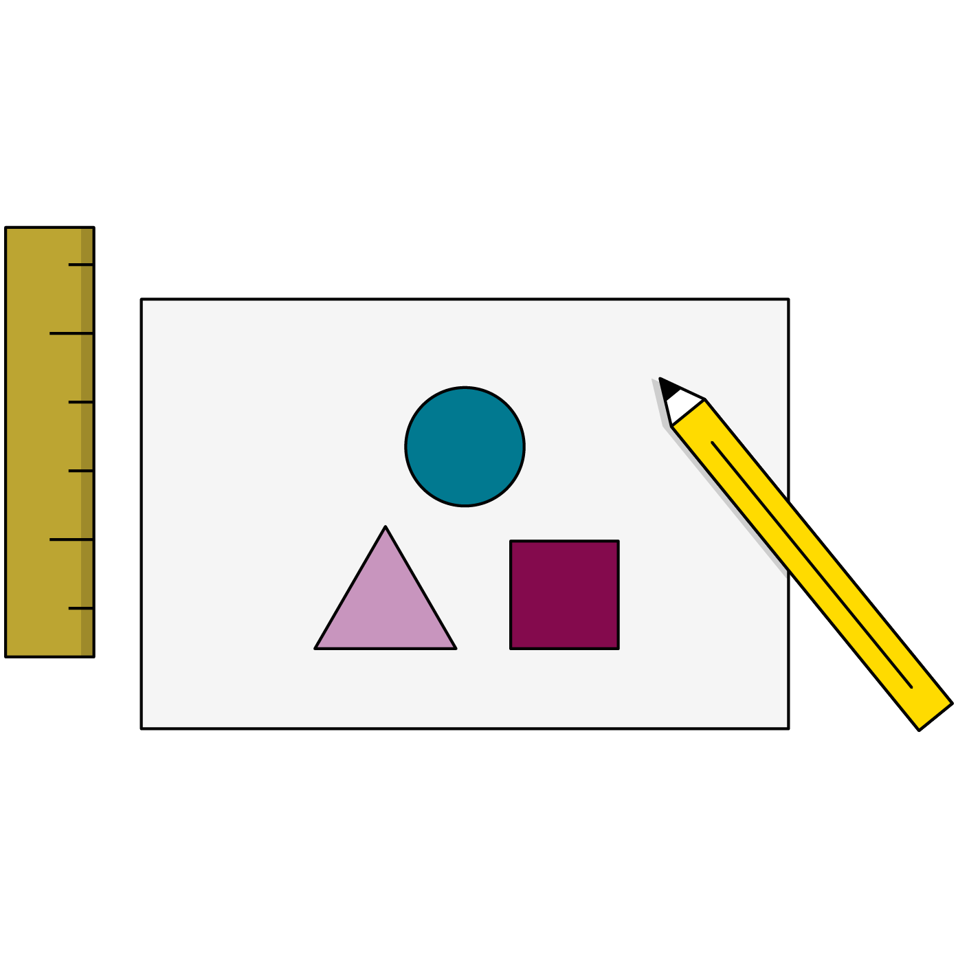
Quick Styling Tips
Always put a new style on a new line.
Try to organize styles logically by section.
Use external style sheets that are linked in the head of your HTML document.
Use whitespace so people can read your code.
Comments are welcome in your CSS.
‹#› | © 2020 General Assembly

Slide 34
Key Takeaways
For Next Time
CSS Cascades Through the DOM
The CSS Box Model
Style is defined in terms of properties and values.
Using the right selectors can apply consistent styles across the whole page.
Semantic HTML helps coordinate with CSS.
Complete Homework No. 1
The box model defines spacing and sizing of elements.
‹#› | © 2020 General Assembly

